Slide 1
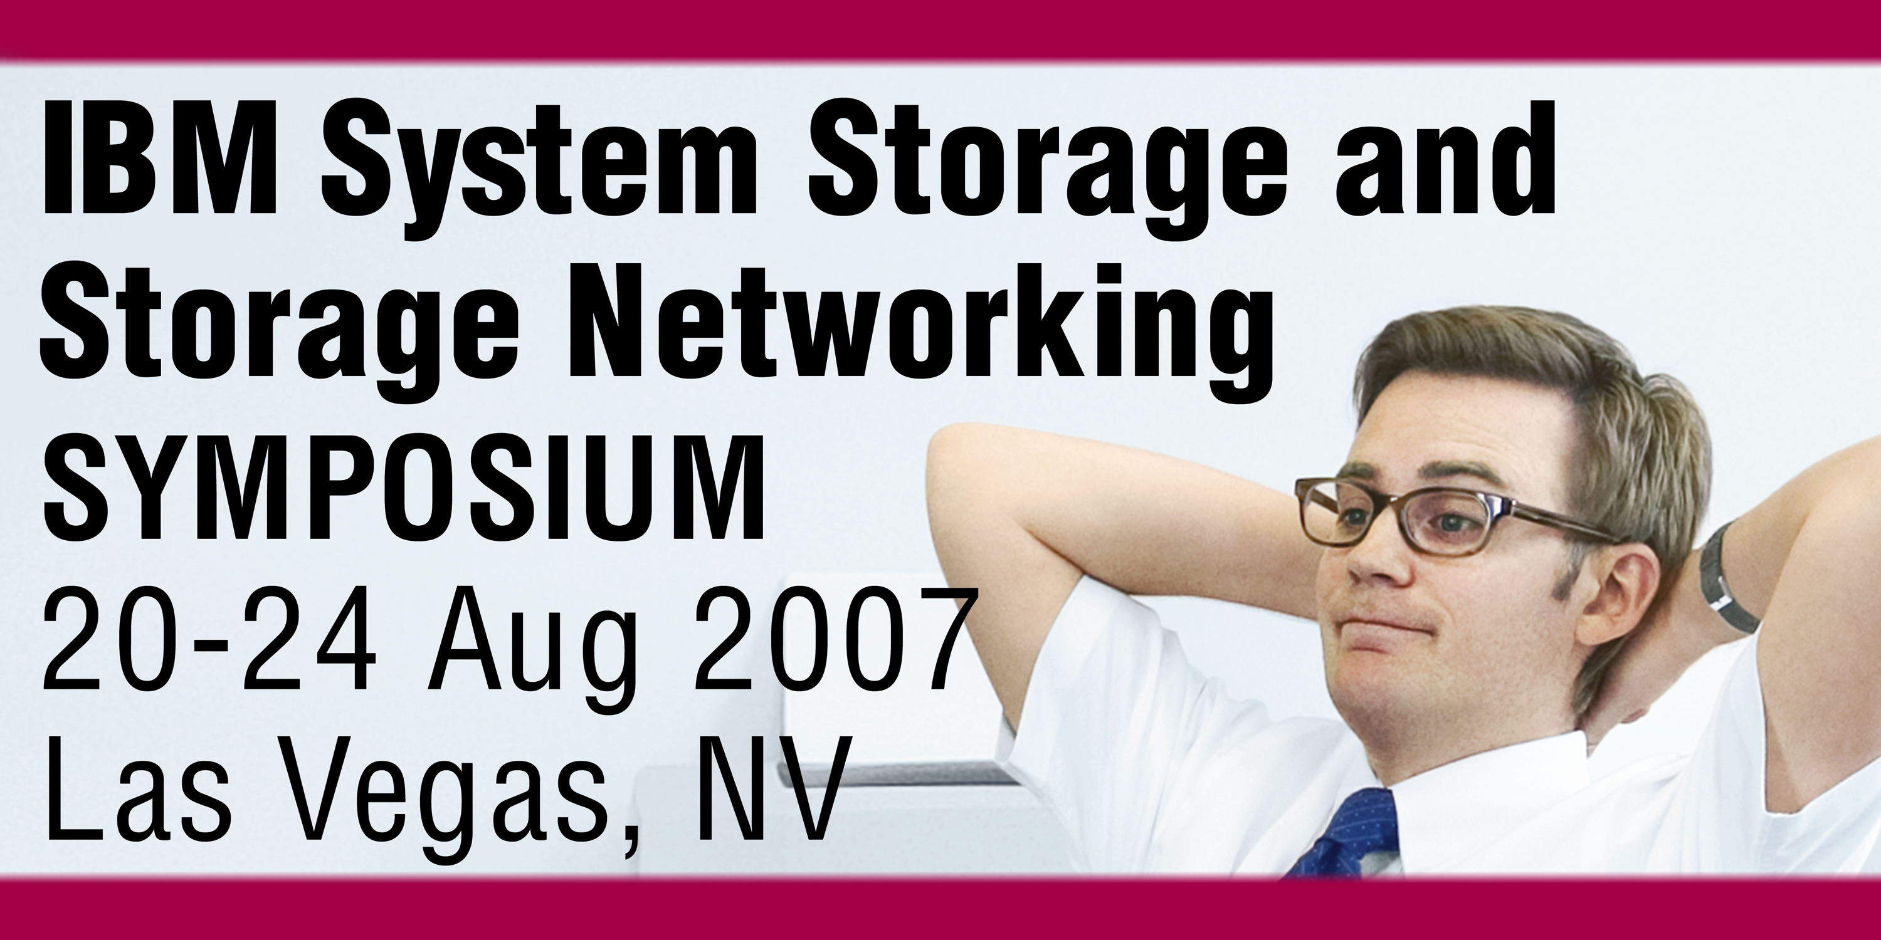
IBM TRAINING
®
Z18
Managing Tape across your Enterprise
Mike Wood woodmw@uk.ibm.com

Slide 2
Trademarks
The following are trademarks of the International Business Machines Corporation in the United States and/or other countries.
* Registered trademarks of IBM Corporation
The following are trademarks or registered trademarks of other companies.
Intel, Intel logo, Intel Inside, Intel Inside logo, Intel Centrino, Intel Centrino logo, Celeron, Intel Xeon, Intel SpeedStep, Itanium, and Pentium are trademarks or registered trademarks of Intel Corporation in the United States, other countries, or both.
Java and all Java-based trademarks and logos are trademarks of Sun Microsystems, Inc., in the United States, other countries or both.
Linux is a registered trademark of Linus Torvalds in the United States, other countries, or both.
UNIX is a registered trademark of The Open Group in the United States and other countries.
Microsoft, Windows, Windows NT and the Windows logo are trademarks of Microsoft Corporation in the United States, other countries, or both.
Red Hat, the Red Hat "Shadow Man" logo, and all Red Hat-based trademarks and logos are trademarks or registered trademarks of Red Hat, Inc., in the United States and other countries.
SET and Secure Electronic Transaction are trademarks owned by SET Secure Electronic Transaction LLC.
* All other products may be trademarks or registered trademarks of their respective companies.
Notes:
Performance is in Internal Throughput Rate (ITR) ratio based on measurements and projections using standard IBM benchmarks in a controlled environment. The actual throughput that any user will experience will vary depending upon considerations such as the amount of multiprogramming in the user's job stream, the I/O configuration, the storage configuration, and the workload processed. Therefore, no assurance can be given that an individual user will achieve throughput improvements equivalent to the performance ratios stated here.
IBM hardware products are manufactured from new parts, or new and serviceable used parts. Regardless, our warranty terms apply.
All customer examples cited or described in this presentation are presented as illustrations of the manner in which some customers have used IBM products and the results they may have achieved. Actual environmental costs and performance characteristics will vary depending on individual customer configurations and conditions.
This publication was produced in the United States. IBM may not offer the products, services or features discussed in this document in other countries, and the information may be subject to change without notice. Consult your local IBM business contact for information on the product or services available in your area.
All statements regarding IBM's future direction and intent are subject to change or withdrawal without notice, and represent goals and objectives only.
Information about non-IBM products is obtained from the manufacturers of those products or their published announcements. IBM has not tested those products and cannot confirm the performance, compatibility, or any other claims related to non-IBM products. Questions on the capabilities of non-IBM products should be addressed to the suppliers of those products.
Prices subject to change without notice. Contact your IBM representative or Business Partner for the most current pricing in your geography.

Slide 3
Agenda
Tape Management Challenges
IRMM Integrated Removable Media Manager for System z
DFSMSrmm
Integrating IRMM and DFSMSrmm
Tape Manager for z/VM
Integrating Tape Manager for z/VM with DFSMSrmm

Slide 4
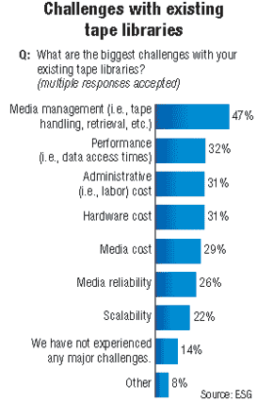
Today‘s tape and media management challenges
Customers increasingly have a need for consolidated tape / media management solutions
  Hardly any tools for open systems tape / media management beyond what’s build in to backup/archive applications
  z/OS® and open systems attached tapes are managed separately - two systems for doing the exact same thing
  Duplicate administration effort can severely complicates management of steadily growing tape environments.
Hardly any dynamic resource sharing
  Not among open systems and not among z/OS and open systems
  Dedicated hardware resources have to be managed separately
  Inefficient utilization of tape resources
“Tape and media management is starting to become a problem in the distributed space, and customer requirements are extending beyond the simple tools available in the backup products today.”
“Dynamic device sharing capabilities replace the practice of each backup server owning its own devices and support dynamic assignment of specific drives to applications as they are needed.”
Source: Gartner

Slide 5
IRMM in a Nutshell
IRMM is a new robust systems management product for Linux® on IBM System z™ that manages open system media in heterogeneous distributed environments and virtualizes physical tape libraries, thus combining the capacity of multiple heterogeneous libraries into a single reservoir of tape storage that can be managed from a central point
IRMM is designed to provide:
  Centralized media and device management
  Dynamic resource sharing
IRMM extends IBM’s virtualization strategy to tape library resources (drives and cartridge pools)
IRMM complements Linux on System z consolidation efforts

Slide 6
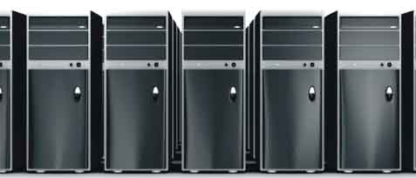
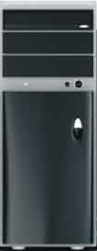


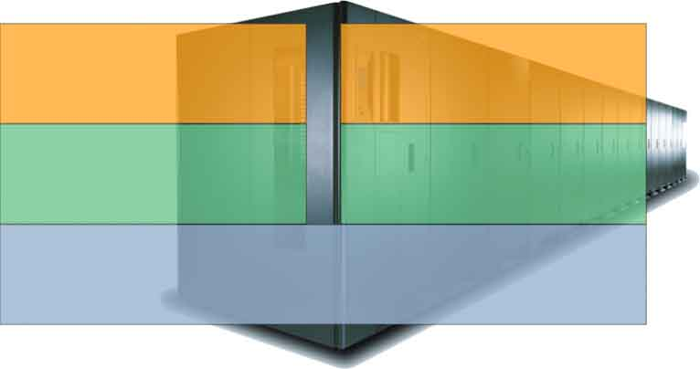
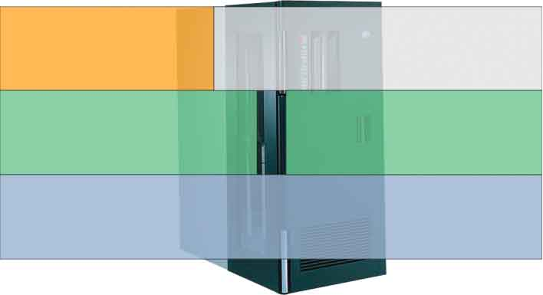
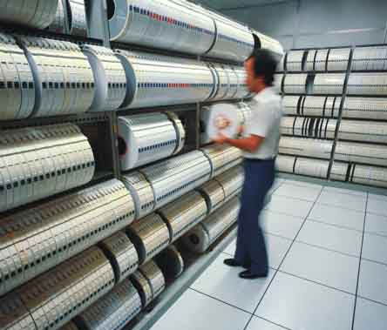
Tape Library Virtualization and Enhanced Tape Resource Management
IEEE 1244 Media Management or 3494 LM Protocol over TCP/IP
Control
Tivoli Storage Manager™ Servers
Tivoli Storage Manager Storage Agents
Other Apps
Data
Media, Library and
Drive Management and
Virtualization Middleware
SAN
IRMM Server
SCSI/FC
SCSI/FC
SCSI/FC
Prop Interface
Streaming
Devices (Drives)
Media Changer Devices
Streaming
Devices (Drives)
Media Changer Devices
Removable Media Hardware
Removable Media Hardware
Libraries with SCSI Media
Changer interface (e.g. IBM TS3500)
Libraries with proprietary interfaces (e.g. IBM 3494)

Slide 7
Tape Library Virtualization and Enhanced Tape Resource Management
IRMM systems management for open systems is designed to provide:
IEEE 1244 Media Management Protocol over TCP/IP
Tape Library Virtualization
  Similar to what SAN Volume Controller provides for disk
  Combines the capacity from multiple heterogeneous libraries into a single reservoir of tape storage which can be managed from a central point
  Increases utilization, availability, administrator productivity and efficiency
  Reduces downtime for planned and unplanned outages and maintenance
  Significantly reduces administration of Tivoli Storage Manager (and other BA products) through “on-demand” provisioning of devices/libraries
Tape Storage/Resource Management
  Includes mainframe-class management of removable media for Open Systems
  Enables single point of control for all removable media mgmt. tasks through integration with z/OS DFSMSrmm
  Advanced tape hardware management, monitoring and reporting
  Policy-based administration tasks
Control
Path
Tivoli Storage ManagerServers
Tivoli Storage Manager Storage Agents
Other Applications
Data
Path
Library Virtualization
& Resource Mgmt.
Middleware Layer
SAN
IRMM Server
SCSI/FC
SCSI/FC
SCSI/FC
Prop Interface
Drives
Changer Devices
Drives
Changer Devices
Removable Media Hardware
Removable Media Hardware
Libraries with SCSI Media
Changer interface
(e.g. IBM 3584)
Libraries with
proprietary interfaces
(e.g. IBM 3494,
STK ACSLS)

Slide 8
IRMM Features
Consolidated, mainframe-class media management services
Centralized repository, access control and administration
Centralized reporting and monitoring
Management beyond physical library boundaries
  Access a cluster of multiple physical libraries as one large logical library
Dynamic sharing of resources across heterogeneous application boundaries and heterogeneous operating systems
  Helps sharing of tape resources much easier
Security features to permit or prevent application access to tapes
  Helps to enable common scratch pool and private pools for every application
  Ensures secure usage and visibility
“virtualizes” the media changer Interface
  Can help to allow selection of best-of-breed software and hardware
“decouples” volumes and cartridge
  Prepared to support all other removable media
  Supports application transparent movement/coping of volumes to other cartridges

Slide 9
IRMM Features (continued)
Policy-based drive and cartridge allocation
Policy-based media-lifecycle management
DFSMSrmm integration
  Consolidated management of tape resources (mainframe and open systems)
z/OS integration
  IRMM command line interface available for z/OS
Tivoli Storage Manager enhancements
  Dismounts all tapes currently mounted when Tivoli Storage Manager stops
  Releases tapes to scratch if open is not successful

Slide 10
IRMM Customer Value Proposition
Reduced TCO through infrastructure simplification and resource optimization:
Increased Admin Productivity through Centralized Management & Administration
  Tivoli Storage Manager Configuration & Maintenance: depends on size of business, e.g. 5 Servers, 20 Storage Agents, 20 Drives, 2 Paths per Drive => manual configuration and maintenance of 25x20x2 = 1000 drive paths! IRMM detects and updates these paths automatically!
  Monitoring & Reporting: Customer won’t have to log at all there server log files. There is a single IRMM instance that provides all data needed for audit trails, usage statistics, etc.!
  Easy and flexible drive provisioning: A service provider can provide logical libraries. In case a customer needs more drives or cartridges these requirements can be configured on demand! Provides policies that let a customer access x drives between 6am-6pm and y drives between 6pm to 6am - an IRMM exclusive!
Increased Resource Utilization
  Due to IRMM’s tape library virtualization capabilities, drive utilization can be increased significantly.
  Customers can implement a common scratch pool.
Preventive Failure Analysis
  Get a warning by Tivoli Enterprise Console alert or email if, for example:
    a drive reaches a certain amount of soft errors or a tape alert event is thrown.
    the number of scratch cartridges reaches a min. threshold
    a path from a server to drive got lost (IRMM supports multipathing)
  Complete overview of the system from just one console available
New Efficiencies with DFSMSrmm
  One consolidated view on tape resources (mainframe and open)
  Use the same polices for mainframe and open systems tape for Retention, Movement and Vaulting

Slide 11




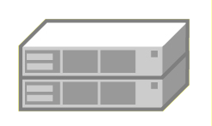



IRMM Architecture
ELM
ELM
ELM
ELM
Media Manager
HDM
HDM
HDM
HDM
Admin Console
SAN
Library
Manager
IRMM
IBM TS3500
IBM 3494
SUN/StorageTek ACSLS Libraries

Slide 12
IRMM Architecture
Command line
interface
Interface
TSM / IRMM
ELM
ELM
ELM
ELM
Media Manager
HDM
HDM
HDM
HDM
Admin Console
Reports all local
device handles
to media manager
Checks path
when cartridges
is loaded
Reports statistical
data to media
manager when
cartridge is unloaded
SAN
Library
Manager
Coordinates access
to drives and cartridges
Central repository
Logs all activities
IRMM
Reports all slots,
drives, and cartridges
to the media manager
Controls libraries on
behalf of the media
manager
Encapsulates
library hardware
IBM TS3500
IBM 3494
SUN/StorageTek ACSLS Libraries

Slide 13
IRMM Architecture
ELM
ELM
ELM
ELM
Media Manager
HDM
HDM
HDM
HDM
Admin Console
SAN
Library
Manager
(1.) Tivoli Storage Manager server wants to mount a scratch tape
IRMM
(2.) Tivoli Storage Manager ELM sends request to Media Manager via TCP/IP
IBM TS3500
IBM 3494
SUN/StorageTek ACSLS Libraries

Slide 14
IRMM Architecture
(3.) Media manager selects scratch cartridge and idle drive
ELM
ELM
ELM
ELM
Media Manager
HDM
HDM
HDM
HDM
Admin Console
SAN
Library
Manager
IRMM
(4.) Media manager forwards request via TCP/IP to the LM
(6.) Drive manager checks path to drive
(5.) Library manager moves cartridge to drive
IBM TS3500
IBM 3494
SUN/StorageTek ACSLS Libraries

Slide 15
IRMM Architecture
ELM
ELM
ELM
ELM
Media Manager
HDM
HDM
HDM
HDM
Admin Console
(9.) Direct access to drive
SAN
Library
Manager
(8.) Response to Tivoli Storage Manager server via TCP and ELM
IRMM
(7.) Media manager updates status
IBM TS3500
IBM 3494
SUN/StorageTek ACSLS Libraries

Slide 16
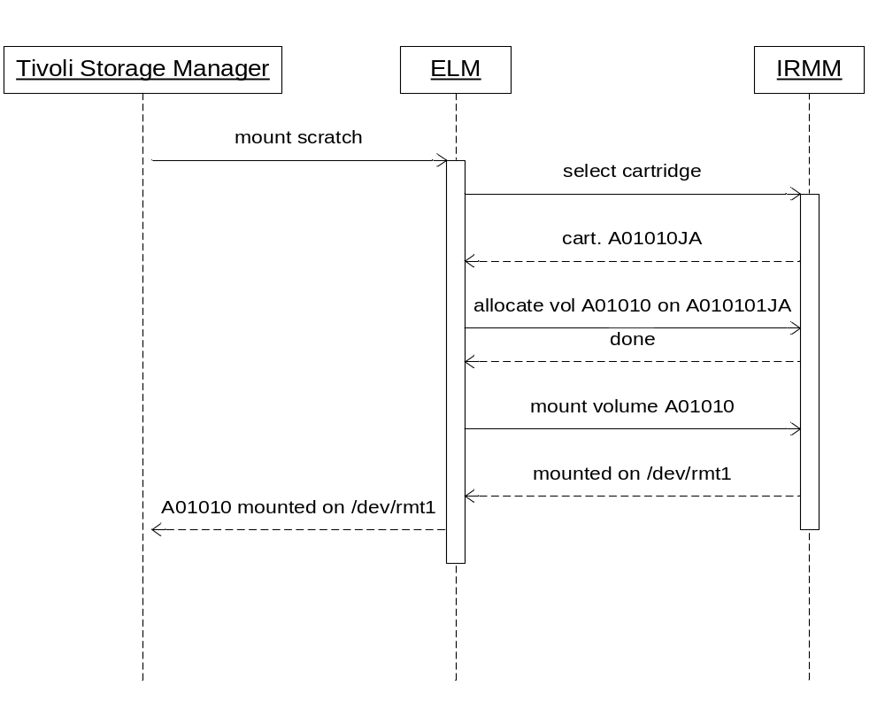
Tivoli Storage Manager and IRMM
How to define IRMM managed resources:
define library libname libtype=external
define path servername libname srctype=server desttype=library externalmanager= /opt/IBM/ermm/client/tsm/elm
define devclass devclassname library=libname devtype=3592 mountretention=5 mountlimit=20
define stgpool stgpoolname devclassname maxscratch=500
That’s all!
You don’t have to define drives and drive paths!

Slide 17

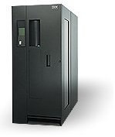
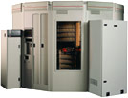
IRMM Tape Library Virtualization
Tivoli Storage Manager
Servers / Storage Agents
Virtual Libraries
presented by IRMM
Physical Tape Storage

Slide 18
Tape Library Virtualization – One Pool of Tape Storage
Logical pool of tape storage beyond physical library boundaries
Applications only have to deal with one library
Physical storage capacity can easily be added without changes to the application
Scratch mounts still possible as long as one physical library is online
IRMM provides workload balancing by distributing scratch mount requests
Preferably done with homogenous physical tape drives / media

Slide 19
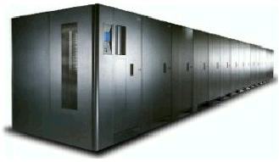
Tape Library Virtualization – Multiple Logical Libraries
Dynamically configurable logical libraries on top of one physical library
IRMM prevents unauthorized application access
Supports heterogeneous environments (such as TS3500 with LTO and TS1120 frames)

Slide 20

IRMM Customer Example
Tivoli Storage Manager & IRMM for backup consolidation on Linux on System z
Metadata
IRMM is designed to provide:
  Highly-scalable Tivoli Storage Manager library manager
  Advanced drive and cartridge management for Tivoli Storage Manager
  Advanced tracking, monitoring and reporting (not available in Tivoli Storage Manager-only environment}
  Features, including mount request queuing, scratch pool management, central reporting, monitoring and access control, scratch-pool management
System z
AIX
Library / Device
Pool Mgmt.
Linux
STA
Linux
Tivoli
Storage
Manager
Server
IRMM
Tivoli Storage Manager
Storage Agent (STA)
Data
SCSI/FCP
z/VM
FCP
Drives
Tivoli
Storage
Manager
Storage
Pools
3584 Tape Library
Slots

Slide 21
Customer References
Volkswagen (Automotive)
  In production since 07/2006
  Maximizes investment due to higher tape resource utilization
  Reduced operational costs due to centralized management of tape infrastructure
HUK Coburg (Insurance)
  In production since 3Q2005
  Dramatically reduced configuration and administration efforts
  Increased resource utilization, advanced reporting, monitoring and failure analysis capabilities
GAD (Financial Services for 470 Banks)
  In production since 11/2006
  Simplified management of growing Tivoli Storage Manager environment
  Non-disruptive backup services even in case of hardware outages

Slide 22
Scriptable Command Line Interface
> ermmtool lscart
PCL Type Library State Group Application
=========================================================
483AFQL2 LTO2 IBM3584 allocated Default ERMMSystem
485AFQL2 LTO2 IBM3584 allocated Default ERMMSystem
486AFQL2 LTO2 IBM3584 allocated Default ERMMSystem
488AFQL2 LTO2 IBM3584 allocated ScratchPool TSM
489AFQL2 LTO2 IBM3584 allocated ScratchPool TSM
490AFQL2 LTO2 IBM3584 allocated ScratchPool TSM
491AFQL2 LTO2 IBM3584 allocated ScratchPool TSM
495AFQL2 LTO2 IBM3584 allocated ScratchPool TSM
496AFQL2 LTO2 IBM3584 allocated ScratchPool TSM
497AFQL2 LTO2 IBM3584 allocated ScratchPool TSM
499AFQL2 LTO2 IBM3584 allocatable ScratchPool
947AAPL2 LTO2 IBM3584 allocatable NoAccess
948AAPL2 LTO2 IBM3584 allocatable ScratchPool
949AAPL2 LTO2 IBM3584 allocatable ScratchPool

Slide 23
IEEE Standard 1244 for Media Management Systems
Architecture for Media Management
Systems (IEEE 1244.1)
Data Model (IEEE 1244.1)
Defines a set of objects, their attributes and their relations
Extends standard relational model by allowing the addition of new attributes to objects
Allows to integrate every kind of removable media (Tape, CD, DVD, MO, etc.)
Applications
MMP
Media Manager
MMP: Media Management Protocol (IEEE 1244.3)
LMP: Library Management Protocol (IEEE 1244.4)
DMP: Drive Management Protocol (IEEE 1244.5)
Asynchronous exchange of text messages over TCP/IP connection (like http, ftp, etc.)
Commands address the specific needs of media-, library and drive management
Powerful language
LMP
DMP
Library
Manager
Drive
Manager
Removable Media Hardware

Slide 24
IRMM Summary
IRMM is a new robust middleware product for Linux on System z that is designed to:
  Help to significantly reduce operational costs by centralizing pro-active tape resource management
  Provide new efficiencies through it‘s tape library virtualization technology and through integration with z/OS and DFSMSrmm
IRMM is based on technology that already has proven it‘s value in everyday production use in large environments
  IBM Service Offering have been in use by customers since 3Q2005
For additional information:
  IRMM – www.ibm.com/nnn/nnn/
  Linux on System z – www.ibm.com/systems/z/os/linux
  z/OS – www.ibm.com/servers/eserver/zseries/zos/
  z/VM – www.ibm.com/eserver/zseries/zvm

Slide 25
DFSMSrmm for z/OS
Removable Media Manager
  IBM's tape management system for z/OS
  A complete, centralized and automated system
Protecting tape data sets from accidental destruction
Manage volume and data set retention and movement
Support and enhance system-managed tapes
An Element of z/OS
For additional information:
  RMM – www.ibm.com/systems/storage/software/sms/rmm/

Slide 26
DFSMSrmm for z/OS . . .
MVS
Journal
RMM
Address
Space
Control
Data Set
USER
Address
Space
S
S
I
Seq.
VSAM
  (EF) KSDS
    (Extended Format)
    Key Sequence Data Set
  LSR
    Local Shared Resource
SSI = Subsystem Interface

Slide 27
DFSMSrmm for z/OS . . .
MVS
RMM
Address
Space
Control
Data Set
Parmlib
EDGRMMxx
S
S
I
USER
Address
Space
Client / Server
MVS
MVS
Parmlib
EDGRMMxx
RMM
Address
Space
Parmlib
EDGRMMxx
RMM
Address
Space
S
S
I
USER
Address
Space
S
S
I
USER
Address
Space

Slide 28
DFSMSrmm for z/OS . . .
Data Set 1
Data Set 1
Data Set 2
DFSMSrmm managed resources
  Volume
  Data Set
  Owner
  Location
    Libraries and vaults
    Rack / Bin
  Policies
    Vital Record Specification
    Data set based
    Volume based
    Retention & Movement
  Software Product
Data Set 2
Previous
Volume
Data Set 3
Data Set 3
Data Set 4
Next
Volume
Data Set 4

Slide 29
DFSMSrmm Policy Management
DSNAME VRS
NAME VRS
Volume VRS
NAME VRS
mask
DSNAME
JOBNAME
GDG\NOGDG
mask
NAME
mask
VOLSER
VOLSER PREFIX
mask
NAME
ANDVRS \ NEXTVRS
ANDVRS \ NEXTVRS
NEXTVRS
ANDVRS \ NEXTVRS
policy
COUNT
STORENUMBER
DAYS \ CYCLES \ ...
WHILECATALOG
UNTILEXPIRED
LOCATION
policy
COUNT
STORENUMBER
DAYS \ CYCLES \ ...
WHILECATALOG
UNTILEXPIRED
LOCATION
policy
VOLUMES
DAYS
LOCATION
policy
VOLUMES
DAYS
LOCATION
DELETEDATE
DESCRIPTION
OWNER
DELETEDATE
DESCRIPTION
OWNER
DELETEDATE
DESCRIPTION
OWNER
DELETEDATE
DESCRIPTION
OWNER
RELEASE
PRIORITY

Slide 30
DFSMSrmm for z/OS . . .
Programming Interfaces
User Address Space
RMM AddressSpace
RMM Cmd
TSO
RMM
Cmd
I/F
RMM
REXX
User
Program
REXX Var
RMM
API
Assembler
User
Program
EDGXCI
macro
Structured
Field
Introducer
C++
User
Program
Method call
RMM
HLLAPI
SFI or XML

Slide 31
DFSMSrmm for z/OS . . .
DFSMSrmm Web Service – Overview
xmlSOAP over HTTP
z/OS
Client
z/OS Websphere Application Server
C++ DLL EDGXHCLL
DFSMSrmm Web Service
JNI: runCommandXml()
User Program
Java User Program
RmmJApi
C++: runCommandXml()
C++ User Program
Single Methods of Rel. 1.6
EDGXHINT
DFSMSrmm

Slide 32
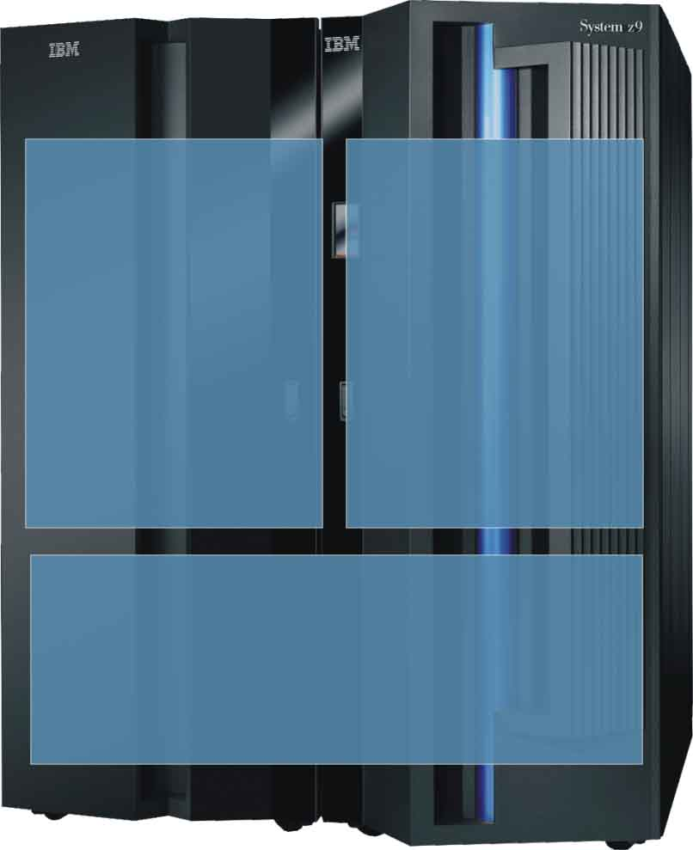




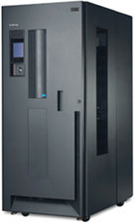
Integrating IRMM and DFSMSrmm
Reduction of TCO for Removable Media Infrastructure by:
  Centralizing management, administration and reporting services
  Enhancing resource utilization through intelligent, dynamic sharing of libraries, drives and cartridge pools
  Virtualizing libraries, drive pools and cartridge pools
  Helps to eliminate changes or downtime for upgrading storage technology
Enabling enhanced Media Protection and Security by:
  Tracking the whole media lifecycle including “in-transit” and offsite locations
  Helps enable enterprise-wide key management for hardware-level tape data encryption
  Security model including access control
ILM Integration of Removable Media by:
  Seamlessly integrating Removable Media in the On Demand storage environment
  Movement of data according to management policies
System z
Clients
(Tivoli Storage Manager Servers)
Linux on
System z
z/OS
IRMM
DFSMSrmm
Linux
AIX
Tape Management
Windows
Solaris

Slide 33
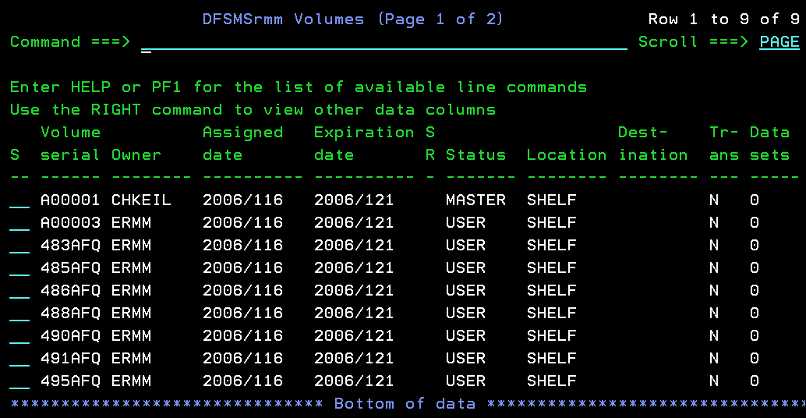
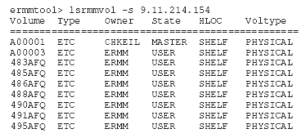
Integrating IRMM and DFSMSrmm (continued)
z/OS
Linux on System z
xmlSOAP over HTTP
z/OS WebSphere Application Server
IRMM Command Line
DFSMSrmm Web Service
IRMM
DFSMSrmm
Consolidated view on tape resources
Open systems interface to DFSMSrmm
Consolidated view on tape resources
Centralized retention, movement and vaulting capabilities
Policy-based management of all cartridges (z/OS and open)

Slide 34
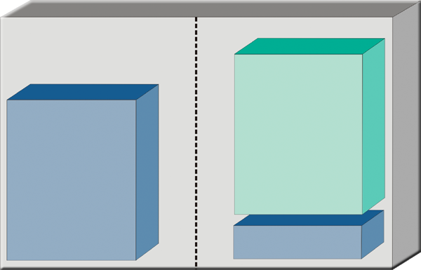

Integrating IRMM and DFSMSrmm (continued)
Linux on System z
Clients
(Tivoli Storage Manager Servers)
Linux
z/OS DFSMSrmm
AIX
TCP/IP
IRMM Server
WebService – TCP/IP
Windows
Solaris
IRMM CLI*
Operator can use z/OS to manage both z/OS and distributed environment!
IEEE 1244 over TCP/IP
* Can run on Linux on System z as well

Slide 35
Tape Manager for z/VM
Manage tapes
  Define tapes in a catalog, including:
    Free or used
    Retention/expiration information
    ATL or manual mount
    Data Security Erase
  Group tapes together into pools
    Ownership and access control
    Media type
Manage devices
  Define available devices
    Dedicated or assignable
  Group devices together into device pools
    ATL/VTS or manual mount
    Any other grouping you choose (read only vs. write, location, etc.)
  Share devices with other systems
Manage mount requests
  Volume specific and scratch requests
    Standard Label
    Non-Label
    Bypass Label Processing

Slide 36
Key Benefits
Effective management of tapes in ATLs
  Granular access control
  Expiration processing
  Notification for low threshold for tape resources
  Interacts with devices through DFSMSRMS on z/VM
Improved accuracy of manual tape processing
  Automated interface to Operator for manual mounts
  Internal label verification at attach/give and detach (SL only)
  Read/Write verification at attach/give
Integrated management of z/OS and z/VM tapes using DFSMSrmm on z/OS
  Optionally use RMM on z/OS as the tape catalog for z/VM and z/OS tapes
  Tapes, access control, and retention managed by the existing RMM catalog
  Accessible via Tape Manager on z/VM
  Tapes managed by RMM
  Devices managed by Tape Manager

Slide 37
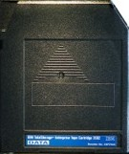
Tape and Device Pools
System free pool
Green: Free
Blue: Used
Red: Manual
Purple: ATL
Private pool DEPTB
Media Type 3490F1
Private pool DEPTA
Media Type
3420F2
Private pool USER1
Media Type 3490F1
Device Pool DEV3420M
Media Type 3420F2
Device Pool DEV3490A
Media Type 3490F1
Device Pool DEV3490M
Media Type 3490F1

Slide 38
Sharing of Tape Devices
z/VM systems with IBM Tape Manager
z/OS systems with IBM Automated Tape Allocation Manager
Linux systems with software supporting mainframe tape devices
Linux A
Linux B
z/VM B
z/VM D
X
z/OS B
z/OS D
X
X
z/VM A
z/OS A
z/OS C
z/VM C
LPAR 1
LPAR 2
LPAR 3
LPAR 4
z9
z9

Slide 39

Tape Manager in Standard Mode
Tape Manager Machine (TMM)
Reads configuration file at startup
Device Manager Machine (DMM)
Library Manager Machine (LMM)
Command Manager Machine (CMM) - Optional
Customer Defined (Optional)
Interacts with real tape devices
Attaches/gives drives to end users
Verifies volume labels
Verifies read/write status
Interacts with DFSMSrms to handle ATL/VTS mounts
Handles volume specific and scratch requests
One for each RMS server
Required for subcommand processing in user exits
Data Security Erase Utility
ATL verification utility
Catalog verification utility
z/VM

Slide 40
Tape Manager for z/VM Summary
Use Tape Manager to
  Manage and share devices
  Manage tape volumes
    Access control
    Retention
    Data Security
  Improve accuracy of mount requests

Slide 41

Integrating Tape Manager with DFSMSrmm
Tape Manager in RMM Mode
Tape Manager Machine (TMM)
z/OS RMM Agent Started Task (VMTMRMM)
IP
DMM
LMM
CMM
Utilities
z/OS RMM Started Task via API (DFRMM)
RMM Manager Machine (RMM)
z/VM
z/OS

Slide 42
Integrating Tape Manager with DFSMSrmm …
Tape Manager for z/VM uses the DFSMSrmm CDS
  All volumes must be defined to RMM
  TAPEMNT and TAPEEOV results in CDS updates
Administrator / User Interface
  Use RMM Subcommands from CMS or on z/OS
    Tape Manager Agent used for commands from CMS
  DFSMSrmm ISPF Dialog on TSO provides user friendly interface
Policy Management
  Data Set name based if data sets name used on TAPEMNT
  Option for Volume based

Slide 43
Enterprise Integration via DFSMSrmm
IRMM
  Virtualizes Open Systems media library
  Enables Device and scratch pool sharing
Tape Manager for z/VM
  Manages libraries media and drives for VM and its guests
  Enables drive sharing across System z
DFSMSrmm
  Manages all media on z/OS
  Provides interfaces for exploitation for heterogeneous systems
    Web service, XML, Rexx
  Robust, mature, policy management for all enterprise media

